Slide 1
Develop a Image-to-Image Translation Model to Capture Local Interactions in Mechanical Networks (GAN)
Capstone Project 2
by Adrien Saremi

Slide 2
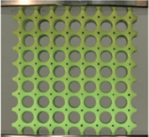
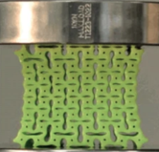
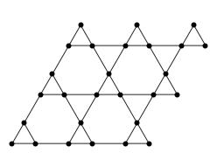
Background - Mechanical Metamaterials
Metamaterials present novel mechanical functionalities
Ability to realize micro-sized systems
Their mechanical properties are governed by the structure
Model to represent metamaterials: structures of sites connected by bonds
Overvelde, et al. Advanced Materials (2012)
Mechanical Network

Slide 3
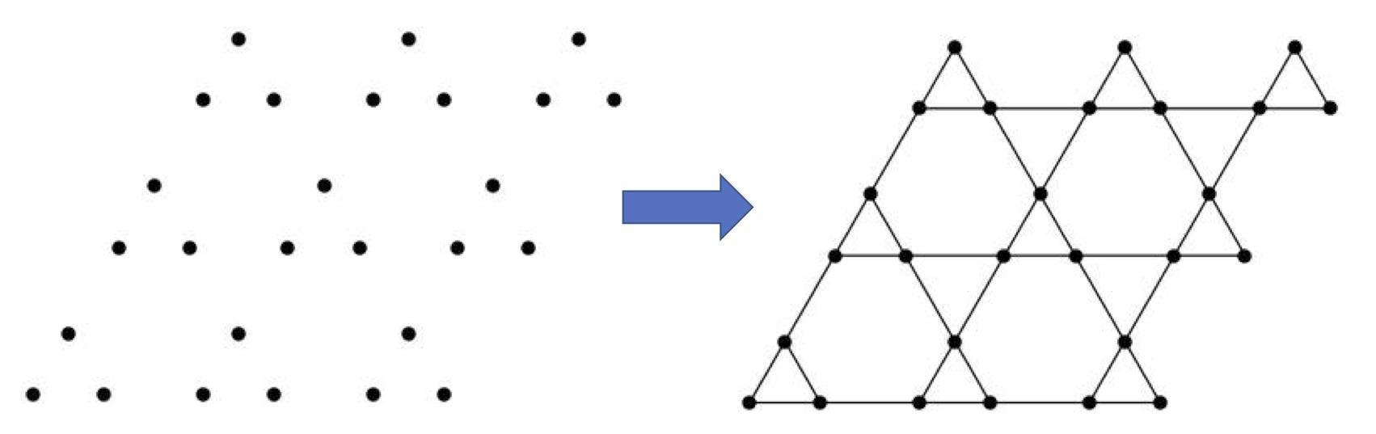
Motivation for this project
The bond connectivity is critical to the mechanical response
Suppose you only know the distribution of the sites?
Is there a way to automatically draw the bond structure?

Slide 4
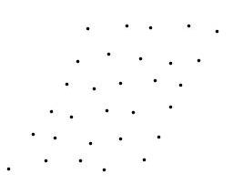
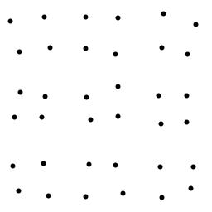
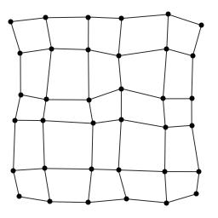
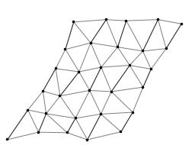
Additional Motivations
Different systems, with different structures.
Can we build a model that both classifies mechanically different systems and plots the bond connectivity?
Deformed square lattice
Deformed
Triangular lattice

Slide 5
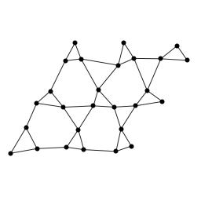
Generating the Data
Fictitious images generated on Mathematica
First cell (the original 3 points) is drawn in the lower-left corner
Remaining cells are generated by discrete geometric translations (periodic structure)
Each point in each cell is then shifted by a small and yet random displacement: the structure carries a long range order but contains small variations from one cell to another
(256 x 256) pixels
jpg format

Slide 6
Methodology
Run notebook on Google Colab
Upload images to Google Drive
Use Google’s GPUs for computer power
Build a Generative Adversarial Network (GAN)
Source: Dr. Jason Brownless for Machine Learning Mastery
https://machinelearningmastery.com/how-to-develop-a-pix2pix-gan-for-image-to-image-translation/

Slide 7
The Generative Adversarial Network (GAN)
Discriminator model
Generator model
Composite model
Training model
Training Data:
30 + 30 images (without and with bonds)
30 + 30 images (without and with bonds)
30 + 30 images (without and with bonds)

Slide 8
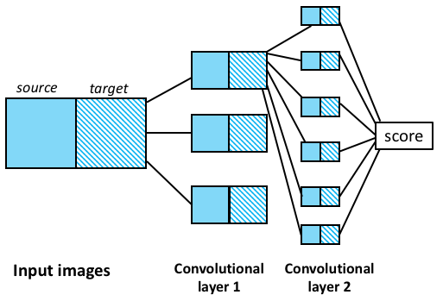
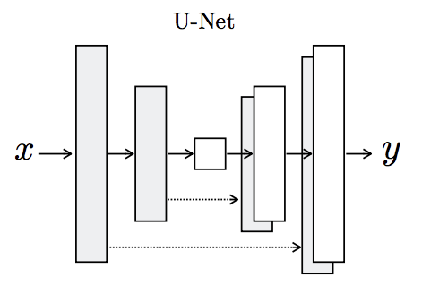
Discriminator
Generator
encoder
decoder
Input:previous output
and output from corresponding layer
(more layers than represented)
Dr. Jason Brownless for Machine Learning Mastery

Slide 9
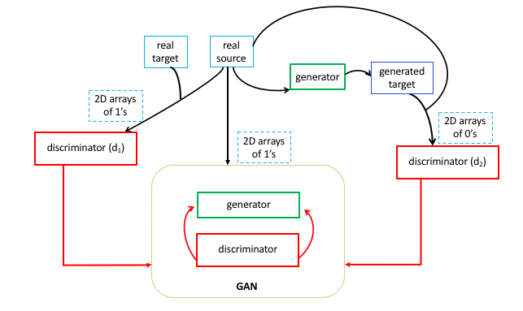
Architecture of Network

Slide 10
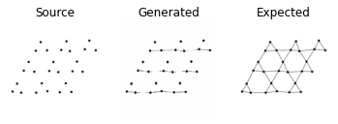
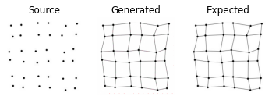
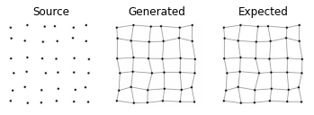
Results: Training Data
6300 / 15000 steps
Iterative
Steps
11200 / 15000 steps
15000 / 15000 steps

Slide 11
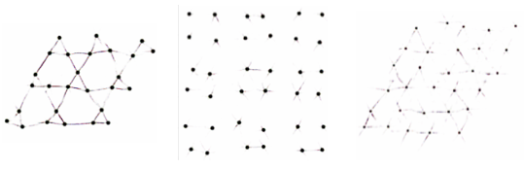
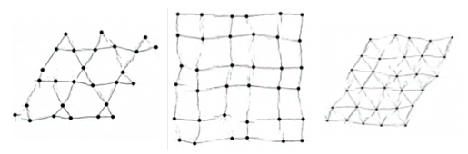
Results: Validation Data
From model based on Kagome structure only
From model based on all three structures
Validation samples: Kagome (left), square (middle), triangular (right)

Slide 12
Conclusion
On a mechanical network:
The GAN model can plot the proper local interactions (aka bond connectivity) needed to identify the mechanical structure of the system.
The position of the sites is unchanged on the generated images: the fundamental properties of the system remain unaltered when processed by the algorithm.
The model can “visually” categorize and plot the local interactions on three distinct mechanical networks: Kagome, square and triangular lattices.

